Slide 1
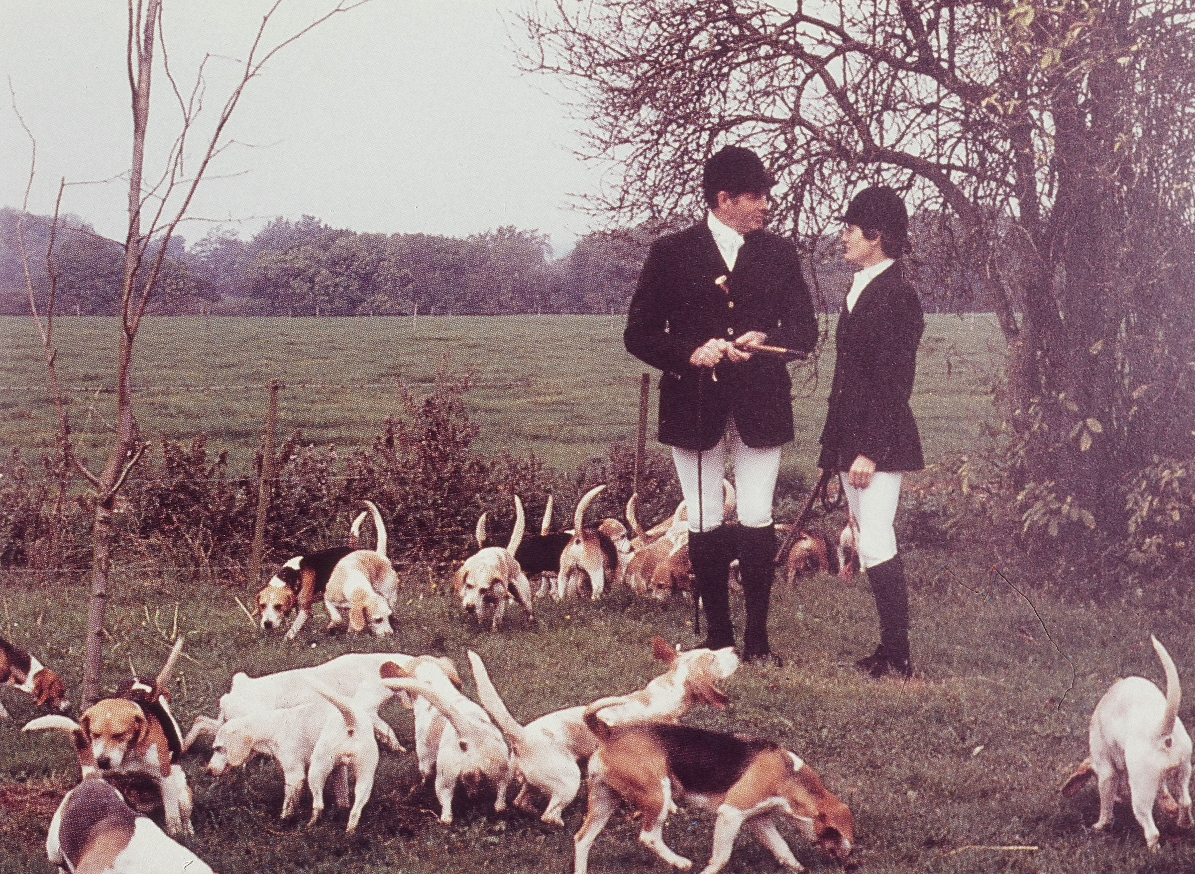
The Beagle

Slide 2

History
References to small Beagle type dogs which hunted hare and were followed on foot date back to 400 BC in Greece and 200 AD in Britain
“Beagle” – Celtic origin…”beag” meaning small and indicative of size of hounds used for hunting
Elizabeth I maintained a pack of small pocket sized Beagles cherished for their melodious “singing” voices

Slide 3
History
Middle of the 18th century hare hunting with Beagles as an aristocratic sport was supplanted by foxhunting
But hare hunting with Beagles continued to thrive as they became the utilitarian hound of choice for farmers and small landholders
Scent hounds, including Beagles, undoubtedly accompanied early English settlers in America

Slide 4
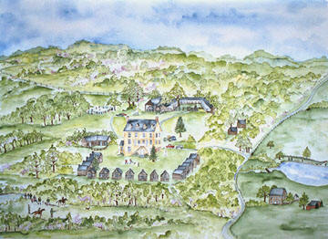
History
AKC established in 1884
First American standard written in 1887 by Gen Rowett who had imported some of the first registered Beagles – today’s standard was written in 1957 making it one of the oldest standards still in use
The National Beagle Club of America established in 1890
1916 – The Institute Corporation formed & purchased the 400 acre Institute Farm in Aldie, VA as the home for NBC activities

Slide 5
History

Slide 6
Function/Comparison
Beagles – (max 15”) hunt rabbits or hare – followed by hunters on foot…”Foot Hounds”
Harriers – (18-22”) hunt hare – followed on foot or horseback
Foxhounds – (English: 24”) hunt fox – followed on horseback
Temperament – all are pack hounds
Endurance – all are ALL DAY hunters

Slide 7
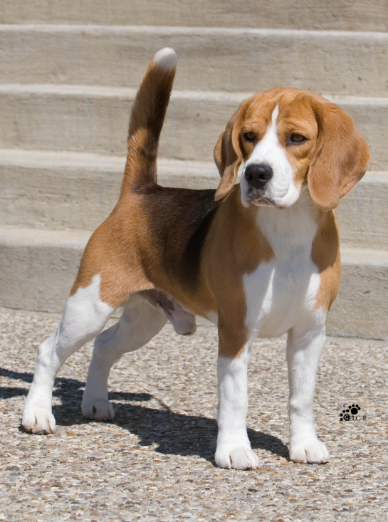
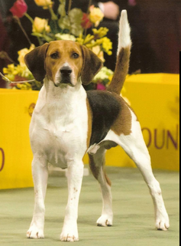
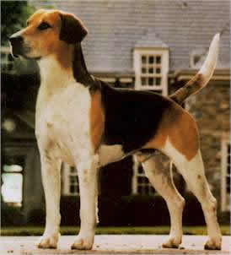
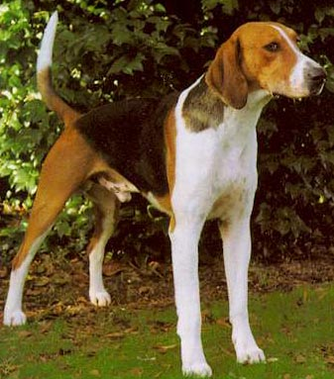
Comparison
Beagle
Harrier
English Foxhound
American Foxhound

Slide 8
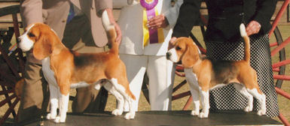
One Breed - Two Varieties One Disqualification
There shall be two varieties:
Thirteen Inch – which shall be for hounds not exceeding 13” in height
Fifteen Inch – which shall be for hounds over 13” but not exceeding 15” in height
Any hound measuring more than 15” shall be disqualified

Slide 9
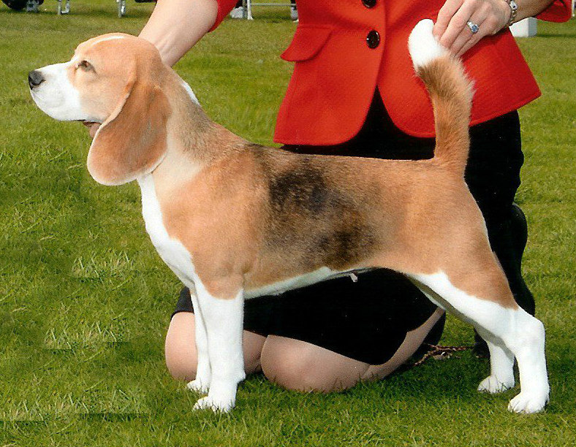
General Appearance
A miniature Foxhound, solid and big for his inches, with the wear-and-tear look of the hound that can last in the chase and follow his quarry to the death.

Slide 10
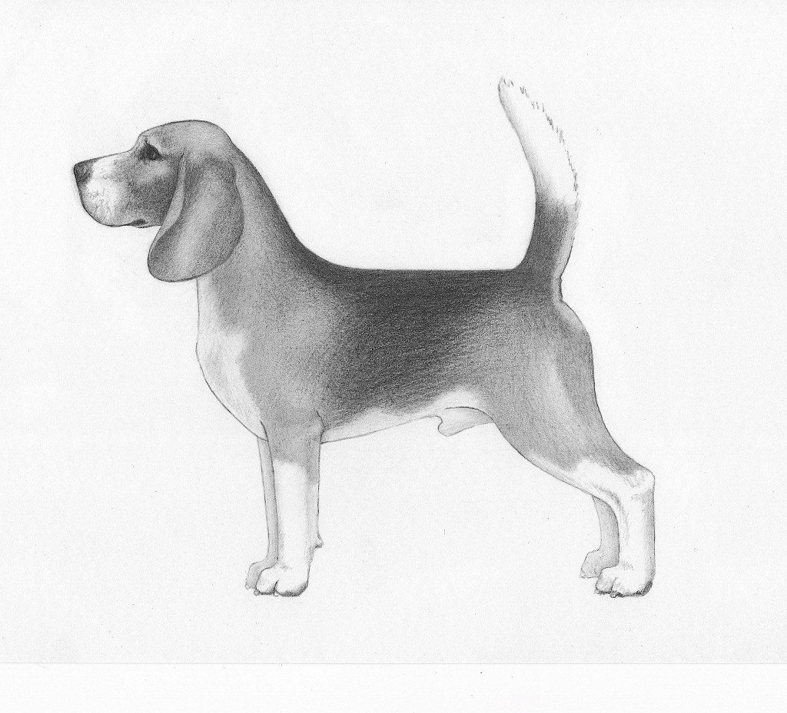
General Appearance
A miniature Foxhound, solid and big for his inches, with the wear-and-tear look of the hound that can last in the chase and follow his quarry to the death.

Slide 11
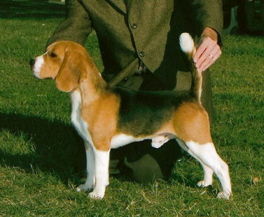
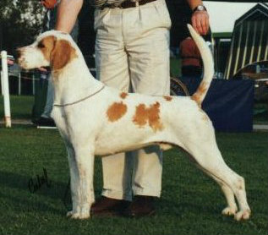
Miniature English Foxhound
The proper English Foxhound is a beautifully proportioned hound, elegant in style, balanced fore and aft and nicely boned. “Big for its inches” means plenty of bone (particularly the round bone of the forelegs) for the height of the hound. Too much bone results in coarseness, too little in a spindly look. There should be no suggestion of ‘toyishness”.

Slide 12
Point Scale
Head - 25
Body - 35
Running Gear - 30
Coat - 5
Stern - 5
Total 100

Slide 13
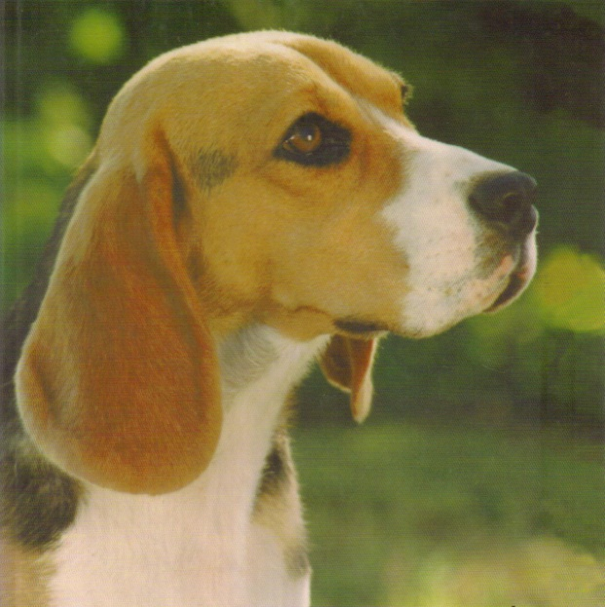
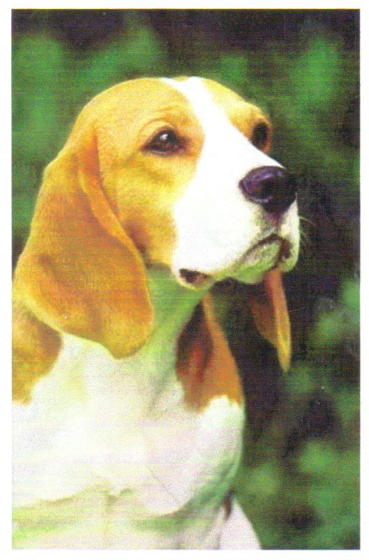
Schedule of Points - Head
Skull – 5
Ears – 10
Eyes - 5
Muzzle-5
Total 25

Slide 14
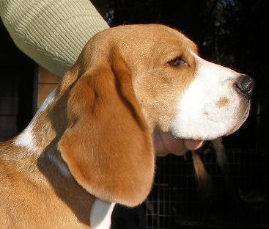
Head – Skull
Skull (5 pts): The skull should be fairly long, slightly domed at occiput, with cranium broad and full.

Slide 15
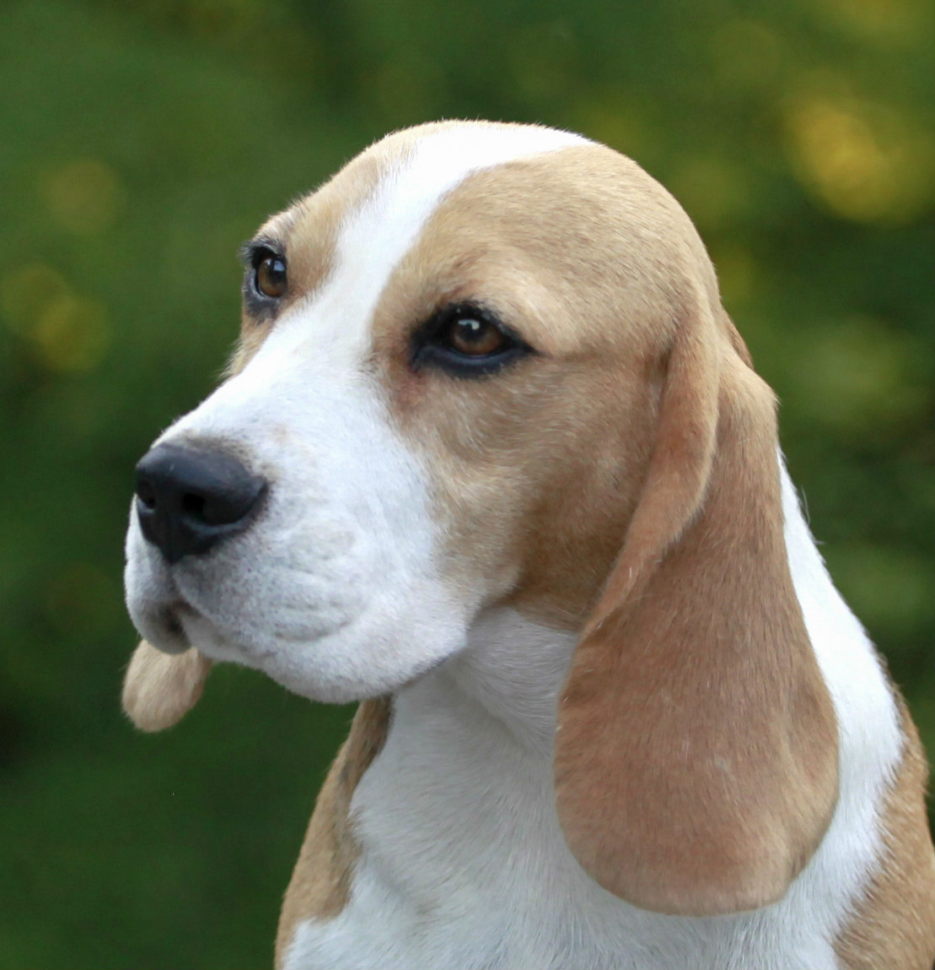
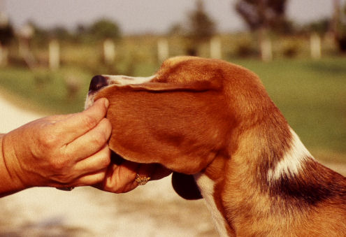
Head – Ears
Ears (10 pts): Set on moderately low, long, reaching when drawn out nearly, if not quite, to the end of the nose; fine in texture, fairly broad – with almost entire absence of erectile power – setting close to the head, with the forward edge slightly inturning to the cheek – rounded at the tip.

Slide 16
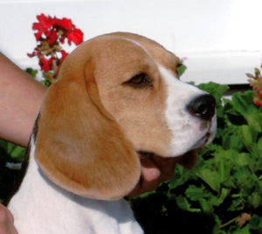
Head – Ears
The ears should be set on level with the outer corner of the eye. Ear length is important for gathering scent in the field. While nearly lacking erectile power, the base will rise a bit when excited, but not above the level of the topskull.

Slide 17
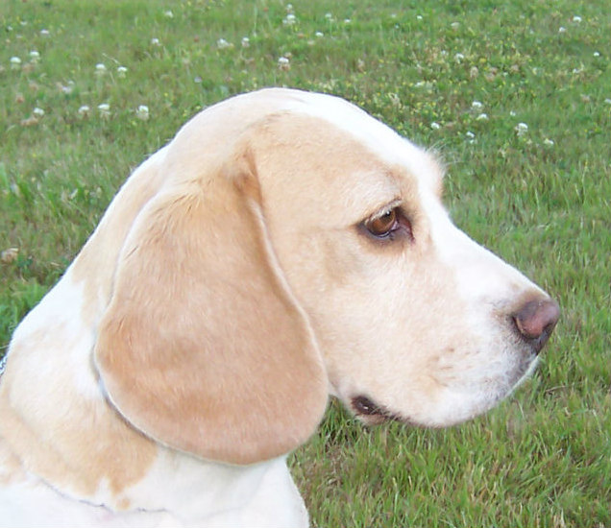
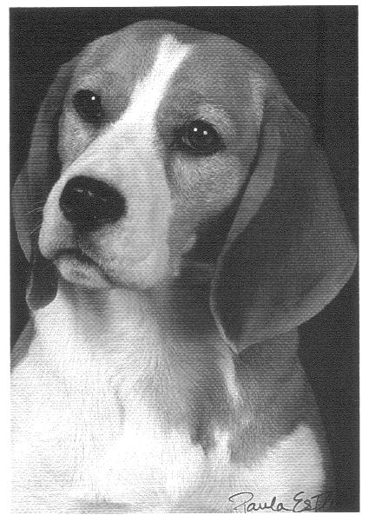
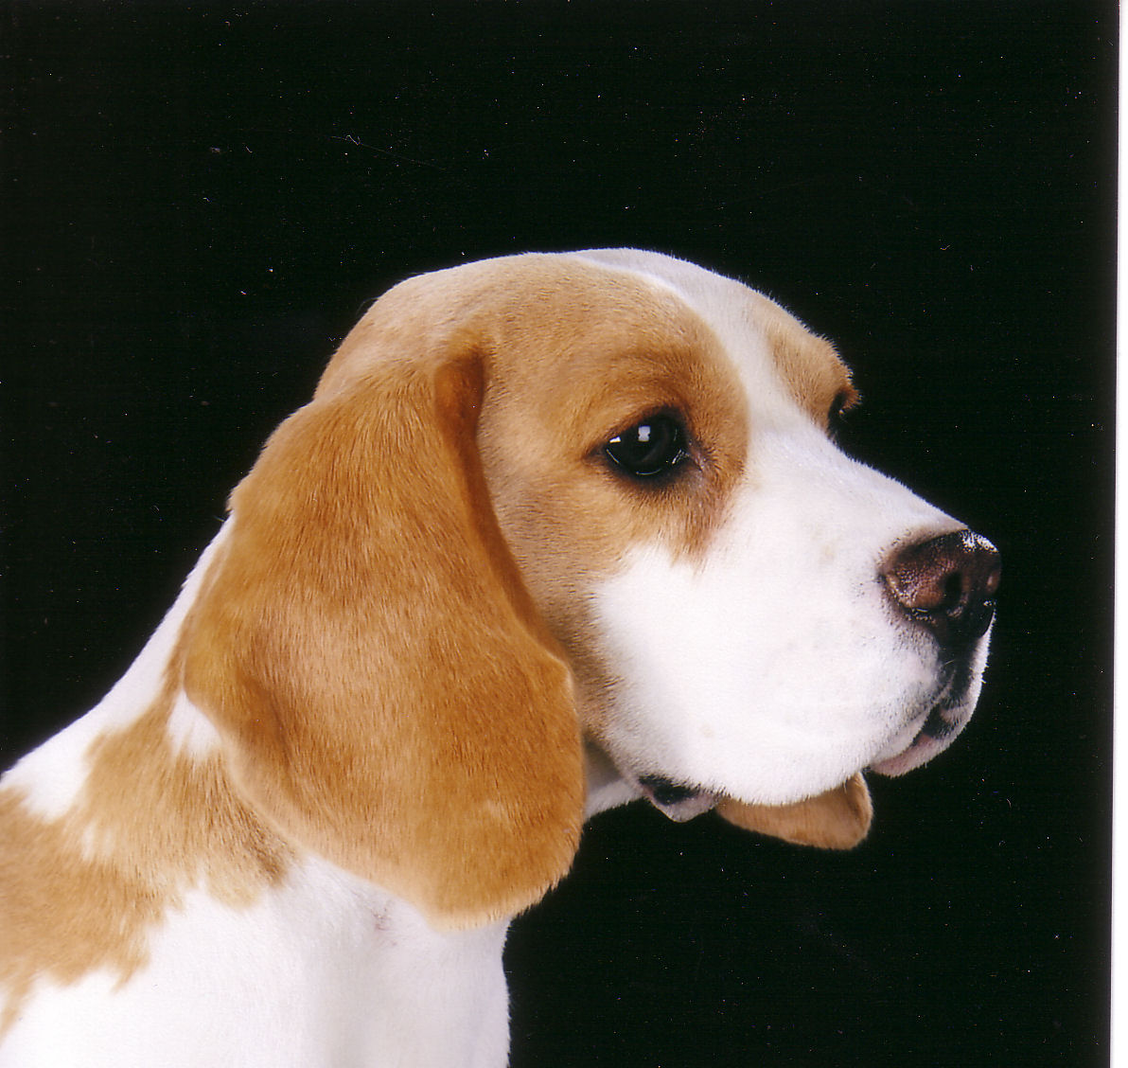
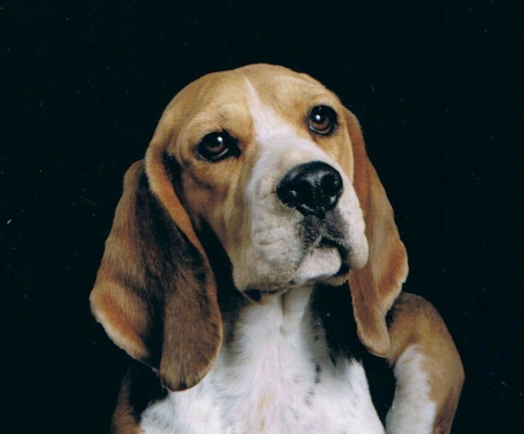
Head – Eyes
Eyes (5 pts): Eyes large, set well apart – soft and houndlike – expression gentle and pleading; of a brown or hazel color.
female
male

Slide 18
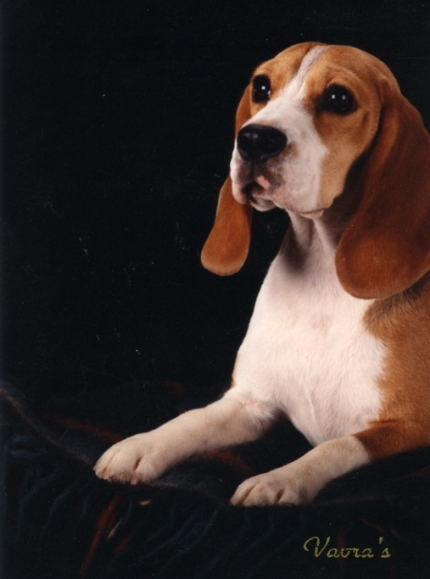
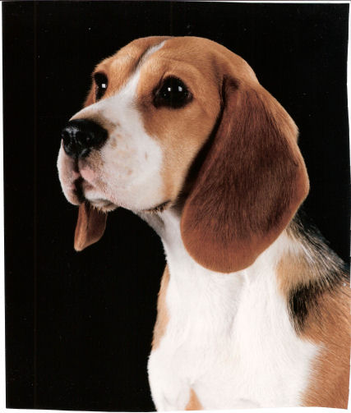

Head – Eyes
The shape of the eye should be round to almond, always soft and expressive. Color of the Beagle’s eyes should fit the coloration of the hound, but preferably darker rather than lighter. While pigmented eye rims are necessary to achieve a “soft” expression, an abundance of black pigmentation, “mascara”, is not. A “gentle, pleading expression” is a factor of a correct eye shape and size, combined with a generally darker eye color. A smaller eye is to be penalized, as are yellow or blue eyes as they give an improper expression.

Slide 19
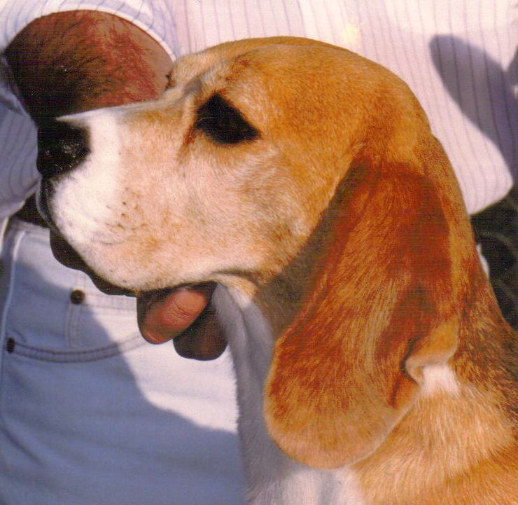
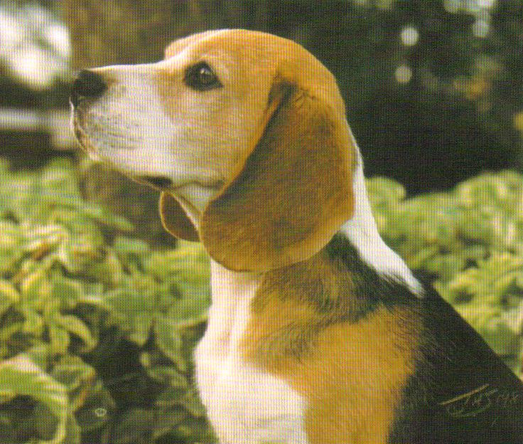
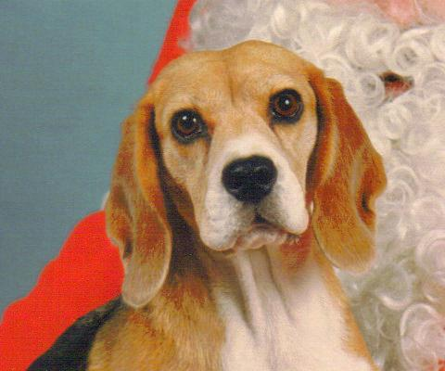
Head – Muzzle
Muzzle (5 pts): Muzzle of medium length – straight and square cut – the stop moderately defined
Jaws – Level. Lips free from flews; nostrils large and open

Slide 20
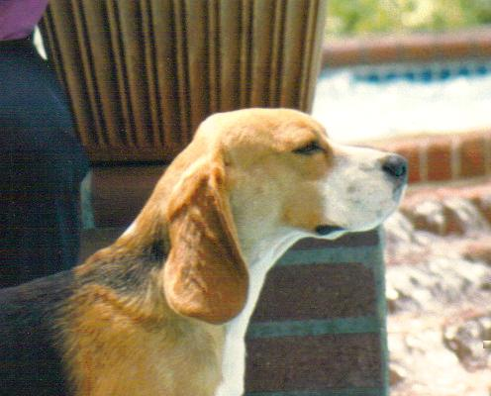
Defects
Flat Skull

Slide 21
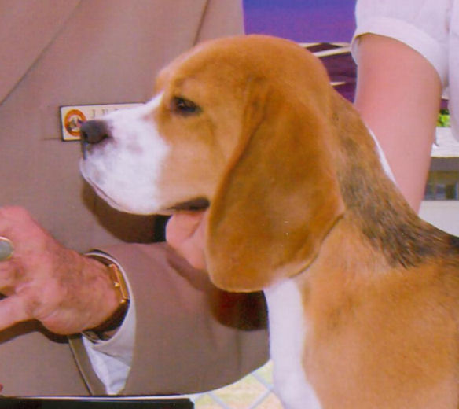
Defects
Excess of dome
(picture also displays excess stop)

Slide 22
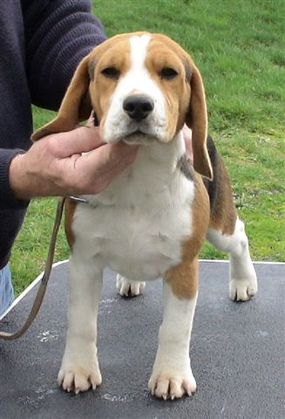
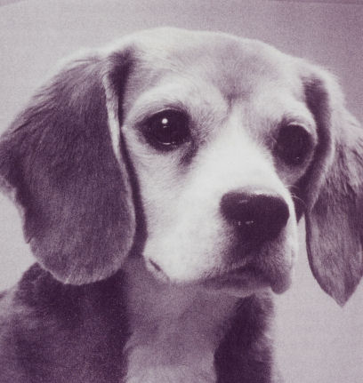
Defects
Eyes small, sharp and terrierlike, or prominent and protruding

Slide 23
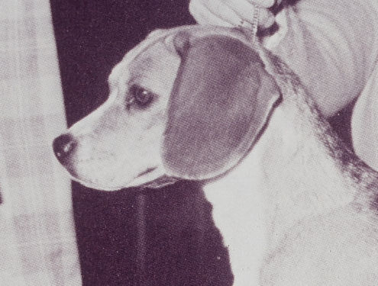
Defects
Muzzle long, snipy or cut away decidedly below the eyes, or very short
Roman nosed, or upturned, giving a dish-face expression

Slide 24
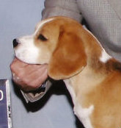
Defects
Ears short, set on high or with a tendency to rise above the point of origin

Slide 25
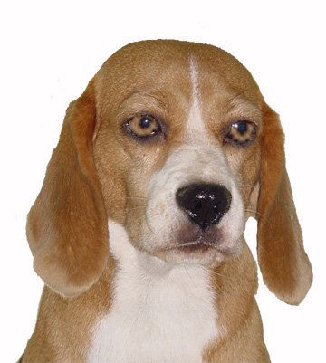
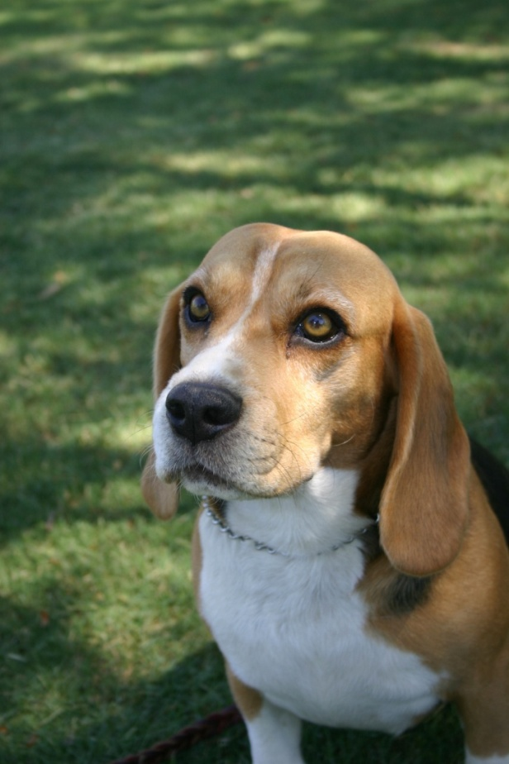
Defects
Light eyes

Slide 26
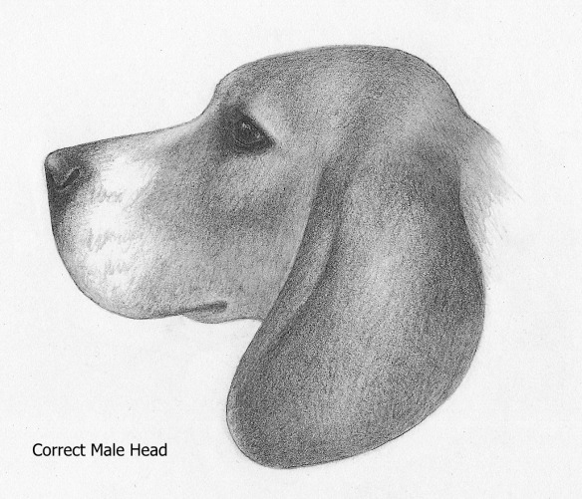
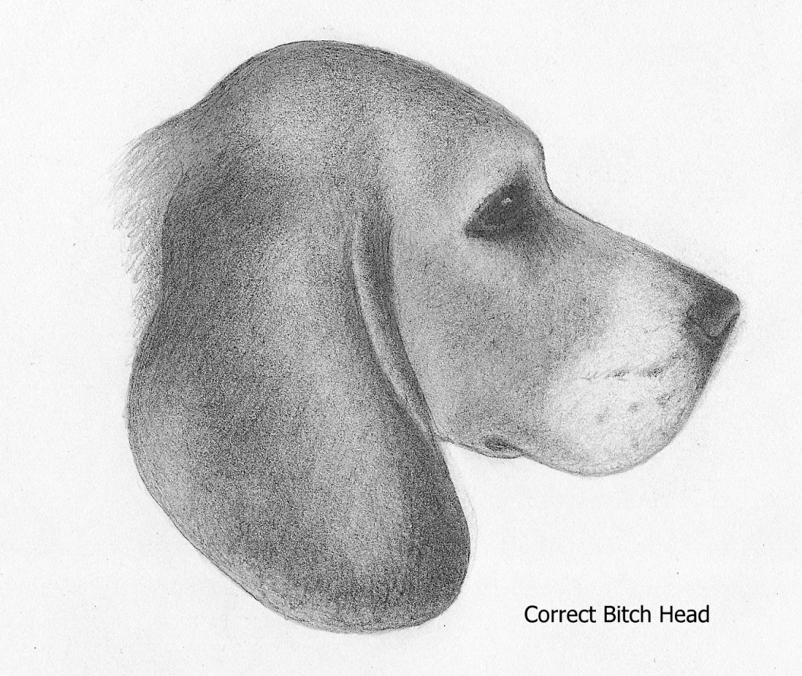
Head

Slide 27
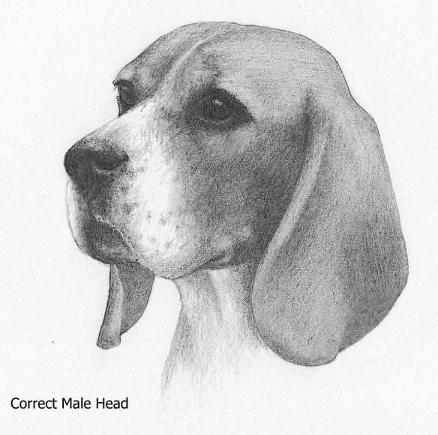
Head
The head accounts for 25% of the scale of points in the Beagle Standard, and while it is a hallmark of the breed, the Beagle is by no means a “head breed”. The head is important and should be carefully studied to understand correct construction. But, do not judge the Beagle as a “head breed”, recognize a correct head, but place importance to the functional portion of the hound, the body.

Slide 28
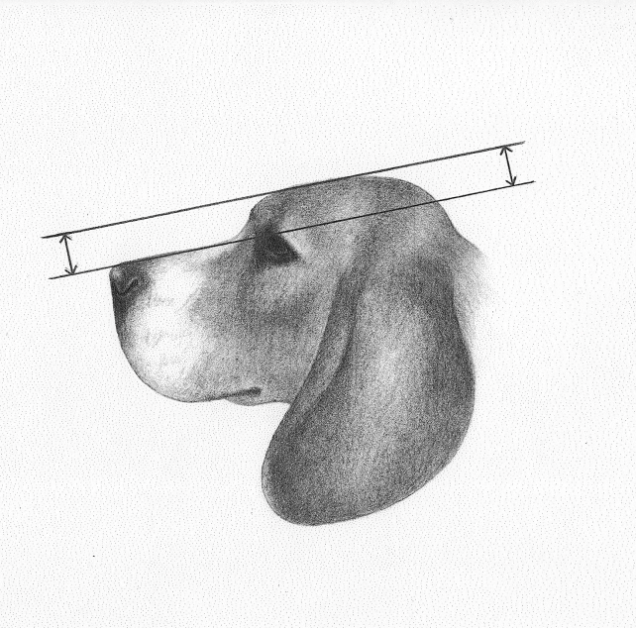
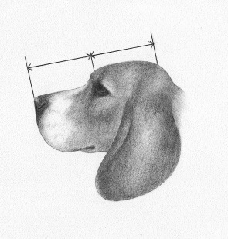
Head
While the planes of the top skull and muzzle should be parallel, the top skull is not flat, it rounds gently to the occiput. The length of skull from occiput to stop should be approximately equal to the length of muzzle from stop to tip of nose. The stop should be moderate with no indication of ‘dishiness’ as in a Pointer or Cocker head.
Although not specifically mentioned in the standard, most breeders agree that the head should be free from wrinkle, as a wrinkled head can create a “worried” and unappealing expression.

Slide 29
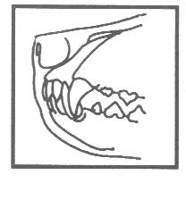
Jaws – Level / Bite
There is no specific mention of the bite in the Beagle Standard, but the English Foxhound Standard calls specifically for teeth which meet squarely, neither overshot nor undershot. The level jaw asked for in the Beagle Standard indicates that a scissors bite is preferred in the Beagle, but a level bite is acceptable. An occasional skewed or missing tooth is not to be penalized.

Slide 30
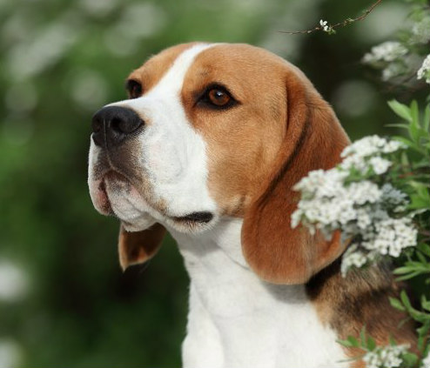
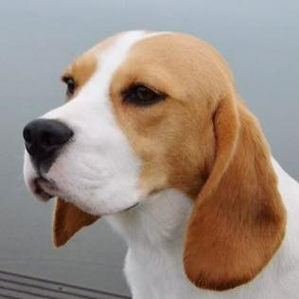
Correct Heads
male
female

Slide 31

Correct Heads

Slide 32
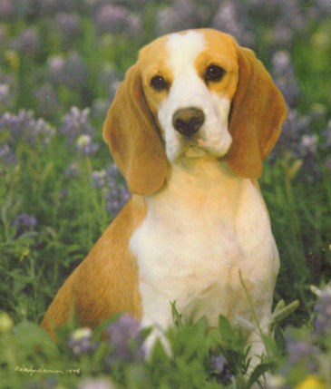
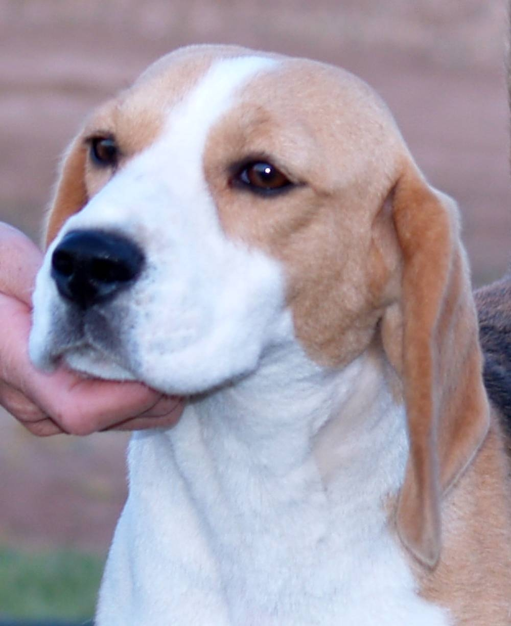
Correct Heads

Slide 33
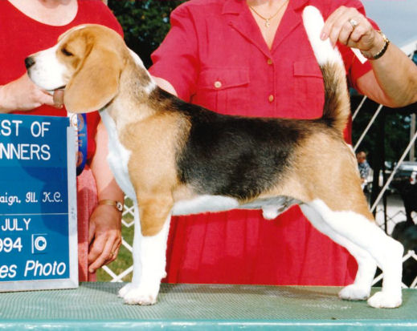
Schedule of Points - Body
Neck – 5
Chest & shoulders- 15
Back, Loin and Ribs- 15
Total – 35 points

Slide 34
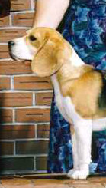
Neck & Throat
Neck and Throat (5 pts): Neck rising free and light from the shoulders strong in substance yet not loaded, of medium length. The throat clean and free from folds of skin; a slight wrinkle below the angle of the jaw, however, may be allowable. Defects: A thick, short, cloddy neck carried on a line with the top of the shoulders. Throat showing dewlap and folds of skin to a degree termed “throatiness.”

Slide 35
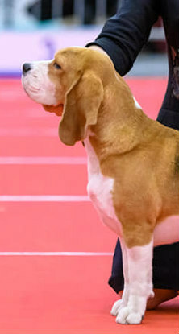
Neck & Throat
Correct length
Well arched
Throat clean and free from folds of skin
Slight wrinkle below angle of jaw allowable

Slide 36
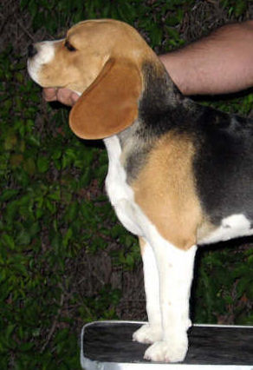
Neck and Throat - Defects
Short, thick, cloddy neck
Carried on a line with the top of the shoulders
Dewlap and folds of skin to a degree termed “throatiness”

Slide 37
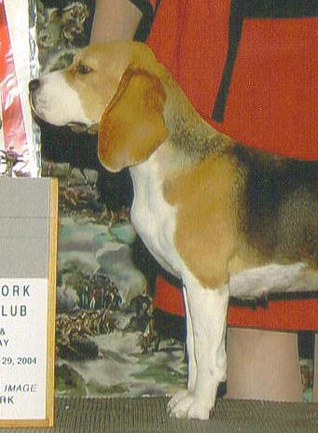
Shoulders & Chest
Shoulders and Chest (15 pts): Shoulders sloping–clean, muscular, not heavy or loaded–conveying the idea of freedom of action with activity and strength. Chest deep and broad, but not broad enough to interfere with the free play of the shoulders. Defects: Straight, upright shoulders. Chest disproportionately wide or with lack of depth.
Notes:
A good shoulder assembly is critical in an endurance hound. The shoulders are flat, without evidence of short, bunched, or bulging muscles over them. The shoulder blades are long having little space between them. A strong neck fits neatly into the long, well laid back shoulders.

Slide 38
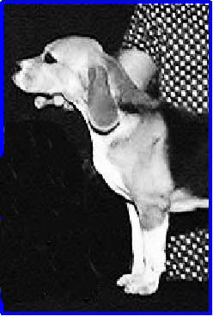
Shoulders
A line dropped from the tip of the scapula to the ground will fall through the front legs in a correct shoulder assembly.
Notes:
In a proper shoulder assembly, the dog will have some forechest. The forelegs will be set well under the hound and will extend downward through the deepest portion of the chest. The length of the scapula should be equal to the length of the upper arm.

Slide 39

Shoulders
Notes:
Good example of a sloping shoulder with adequate return of upper arm.

Slide 40




Chest
Chest deep and broad but not broad enough to interfere with the free play of the shoulders.
Notes:
The chest should be as deep as slightly below the elbow.

Slide 41

Chest & Shoulders
Clean shoulders
Proper amount of front fill
Notes:
When you look at the beagle from the front, the shoulders should appear clean, not heavy or loaded. And with out evidence of short, bunched or bulging muscles. Defects include a chest disproportionately wide or with lack of depth. These hounds display proper width and depth of chest.

Slide 42




Incorrect Fronts/Shoulders/Chests
Notes:
Front legs set too far forward. Extremely short upper arm.

Slide 43

Back, Loin & Ribs
Back, Loin & Ribs (15 pts): Back short, muscular and strong. Loin broad and slightly arched, and the ribs well sprung, giving abundance of lung room. Defects--Very long or swayed or roached back. Flat, narrow loin. Flat ribs.
Notes:
A good shoulder assembly is critical in an endurance hound. The shoulders are flat, without evidence of short, bunched, or bulging muscles over them. The shoulder blades are long having little space between them. A strong neck fits neatly into the long, well laid back shoulders.

Slide 44

Ribs
Well sprung, giving abundance of lung room
Well ribbed back
Notes:
Ribs well sprung and well ribbed back gives the hound as large a thoracic cavity to accommodate a big heart and spacious lungs as is compatible with the individual’s overall size.

Slide 45

Ribs
Ribs springing wide from the spine but reaching their maximum expanse at the top.
The brisket extends downward at least as far as the elbow; desirable if it reaches somewhat below.
Notes:
The length of the body should be occupied largely by the length of the rib cage. Desirable is a ratio of 2/3 ribs and 1/3 loin. A running hound needs a nice long rib cage to provide protection for internal organs and room for heart and lung capacity.

Slide 46

Ribs
The maximum amount of rib spring should be at the top.
Ribs should then gradually round off to the brisket.
Flat or barrel shaped ribs are incorrect.

Slide 47

Sternum
The end of the sternum should be behind the front legs.

Slide 48
Back
Back short, muscular & strong
Topline should be level

Slide 49

Loin
Loin broad and slightly arched
Loin well muscled & strong
Arch in loin is from muscle development. Barely perceptible, felt more than seen.
Notes:
The topline should be level. The “slightly arched” loin of the standard does not mean a roach or the curve of a low tail set. Muscle development along either side of the spine gives the slightly arched look when viewed from behind.

Slide 50

Balance The distance between withers and ground is equally divided by the elbow.
Notes:
The distance between withers and ground is equally divided by elbow.

Slide 51

Proper Underline & Tuck-Up

Slide 52



Back - Defects
very long or swayed or roached back

Slide 53


Short Sternum –Short Ribs

Slide 54


Incorrect Underlines

Slide 55


Balance – Too short on leg

Slide 56

Body
Balance is critical. The length of body measured from prosternum to point of buttock is longer than distance from withers to ground. There should be prosternum visible in front of the shoulder. Additionally, there should be some “dog behind the tail”, which is created by proper angulation of the pelvis as it meets the femur. As a result, the beagle is off square, longer than tall.

Slide 57
Body
Although the standard calls for a short back, the back must have sufficient length to allow for proper rib construction and a well muscled loin. Ribs should extend well back. Back length should be long enough to allow for a ground covering side gait; hounds that are too short coupled will not be able to accommodate the angulation necessary for endurance in the field. A shorter backed beagle is not necessarily more correct.

Slide 58

Body - Neck & Throat
The neck must be long and pliable enough for the nose to reach the ground for tracking without forcing the dog to crouch. There should be a slight arch from where the neck meets the occiput and extends down, blending smoothly into the shoulders.

Slide 59
Body – Shoulders & Chest
There should be forechest visible in front of the shoulders and front legs, allowing for sufficient lung/heart capacity and layback of shoulder. The end of the sternum should be behind the front legs and the brisket should reach at least to, or preferably a bit below, the point of the elbow. The distance between withers and ground is equally divided by elbow and depth of chest.

Slide 60
Body – Shoulders & Chest
In the correct shoulder assembly, a line dropped from the tip of the scapula to the ground will fall through the front leg. The length of the scapula should be equal to the length of the humerus.

Slide 61
Body – Back, Loin & Ribs
The ribs should extend well back, 2/3 of the distance from the withers to the point of hip should be ribbing, the remaining 1/3, the loin. The ribs should spring wide from the spine gradually rounded off as they reach the brisket. Viewed in profile, the Beagle should have a slight tuck-up with a gradual rise in the underline from where it becomes visible behind the front leg to where it disappears behind the rear leg.

Slide 62

Body – Back, Loin & Ribs
The topline should be level. The “slightly arched” loin does not mean a roach or curve resulting in a low tail set. Muscle development along either side of the spine gives the loin a slightly arched look when viewed from above, the front or behind, but not in profile. Viewed from above, the shoulders/chest and the pelvis should be of equal width.

Slide 63
Running Gear
Forelegs – 10
Hips, thighs & hind legs - 10
Feet - 10
Total 30 points
Notes:
A good shoulder assembly is critical in an endurance hound. The shoulders are flat, without evidence of short, bunched, or bulging muscles over them. The shoulder blades are long having little space between them. A strong neck fits neatly into the long, well laid back shoulders.

Slide 64

Forelegs
Forelegs and Feet Forelegs (10 pts): Straight, with plenty of bone in proportion to size of the hound. Pasterns short and straight. Feet (10 pts): Close, round and firm. Pad full and hard. Defects--Out at elbows. Knees knuckled over forward, or bent backward. Forelegs crooked or Dachshundlike. Feet long, open or spreading.
Notes:
From the elbows, the front legs drop absolutely straight to the feet.

Slide 65

Correct forelegs & feet
Notes:
Proper amount of bone, clean shoulders and front fill. Absolutely straight forelegs.

Slide 66

Forelegs - Pasterns
Pasterns short and straight

Slide 67
Feet
Close, round and firm.
Pads full & hard.
Notes:
The feet should be round, small and cat-like. The pad is thick and tough for long usage over rough or rocky terrain without any crippling injury. The feet should be pointed directly forward; any turning in or out should be avoided.

Slide 68

Pasterns - Defects
Sloping pasterns

Slide 69

Pasterns - Defects
Knuckled over
Flat feet

Slide 70

Feet - Defects
Flat, spreading feet

Slide 71

Feet - Defects
Feet long, open or spreading AKC Standard
Pictured is a hare foot

Slide 72


High Toes
Be sure to double check feet to make sure there are no high toes.

Slide 73

Hips, Thighs, Hind Legs
Hips, Thighs, and Hind Legs (10 pts): Hips and thighs strong and well muscled, giving abundance of propelling power. Stifles strong and well let down. Hocks firm, symmetrical and moderately bent. Feet close and firm. Defects--Cowhocks, or straight hocks. Lack of muscle and propelling power. Open feet.

Slide 74

Hips, thighs and hind legs
Hips and thighs strong and well muscled, giving abundance of propelling power

Slide 75

Hips, thighs and hind legs
Stifles strong and well let down.
Hocks firm, symmetrical and moderately bent.
Notes:
The hindquarters are both wide and thick with generous musculature of hams and buttocks. The beagle does not require excessive angulation since the hound is followed on foot and does not require excessive speed. The hindquarters are not straight – mere props. The propulsive power of the dog is developed in the hindquarters through the leverage of its parts and there must be adequate turns of stifle and hock to propel the hound over the ground. The staying power is more important than speed. The thigh and second-thigh are both long and the stifle is well let down and the hock is short. The hind feet are pointed directly forward, turning neither in nor out. The hocks are perpendicular to the floor and hocks show no tendency to converge.

Slide 76

Hind legs
Proper rear angle and ham
Notes:
The hindquarters, like the forequarters, are substantial, with the large bones clothed with powerful muscles, which provide sustained driving power.

Slide 77


Proper rear angle & ham

Slide 78
Hips, thighs & hind legs
Defects –
Cowhocks
Straight hocks
Lack of muscle and propelling power

Slide 79
Straight hocks; lacking rear angle and muscle

Slide 80


Straight rear angle; lacking proper muscle

Slide 81

Proper amount rear muscle
Notes:
The hind legs should form straight columns of support from hip to hock.

Slide 82


Bone
“Big for his inches” (AKC Standard)
Plenty of bone

Slide 83


Lacking proper amount of bone

Slide 84

Running Gear – 35%
Note the requirement of “plenty of bone in proportion to the size of the hound”. A larger circumference of bone will allow for a greater mass of muscle attachment, adding to the endurance of the hound. Too much bone, makes for extra work for the dog and is undesirable. Bone should be round. Pasterns should be straight but flexible, sloping pasterns break down in the field.

Slide 85

Running Gear – 35%
Stifles strong and well let down implies a long femur (upper bone of the hind leg) with moderate angulation at the knee and hock joints. A line drawn down from the point of the buttock will fall to the front of the hind foot.

Slide 86

Running Gear – 35%
Feet account for 10 points, emphasizing their importance. A firm cat foot with hard, full pads allows the Beagle to hunt for hours over difficult terrain. Bent pasterns, flat spreading feet or long feet are ineffective supports for a working hound. Occasionally a foot with an exceptionally short outer toe is seen. A short toe is to be penalized, as it does not allow for a complete foot on the ground, resulting in an ineffective support for balance or turning.

Slide 87

Tail
Tail (5%): Set moderately high; carried gaily, but not turned forward over the back; with slight curve; short as compared with size of the hound; with brush. Defects--A long tail. Teapot curve or inclined forward from the root. Rat tail with absence of brush.

Slide 88

Tail – Proper Brush

Slide 89



Tail Set & Carriage

Slide 90
Tail - Defects
Long tail
Teapot curve or inclined forward from the root.
Rat tail with absence of brush

Slide 91



Tail – Defects
Long tail
Teapot curve
Rat tail

Slide 92

Tail – Proper Brush – BUT…

Slide 93


Defects
Gay Tail
Low Set Tail

Slide 94
Tail – 5%
The tip of the tail should be slightly higher than the head when held at attention. Carriage is perpendicular to the topline and may have a slight curve, never to be inclined forward from the root or carried over or touching the back, as this does not enable the beagle to be followed in the field. Although a white tip serves as a “flag” to reveal his whereabouts in the field, an absence of a white tip is not to be penalized. While adequate brush on the tail is necessary to protect the tail from damage while hunting, more brush is not necessarily better. The tail should be carried upright while gaiting but should never be penalized should it drop when the dog stops

Slide 95

Coat
Coat (5 pts): A close, hard, hound coat of medium length. Defects: A short, thin coat, or of a soft quality. Color: Any true hound color.
The words “Any true hound color” in the Beagle standard cannot be emphasized enough. Any artificial enhancement of coat color is to be penalized.
Notes:
From the elbows, the front legs drop absolutely straight to the feet.

Slide 96


Color
Notes:
Faded tri color

Slide 97

Color
Notes:
Blue. Blue is a dilution of tri or red or liver. This dog is a blue tri.

Slide 98

?? What About Gait ??
Notes:
Blue. Blue is a dilution of tri or red or liver. This dog is a blue tri.

Slide 99

Movement
Beagles should be moved at a moderate trot.
Good reach of front legs and good drive with the rear.
From the front, the forelegs should move straight forward with the hind legs following in the footsteps of the front.

Slide 100

Movement
From the rear, the hocks should move perpendicularly to the ground, moving parallel.

Slide 101



Gait

Slide 102


Lacking reach and drive
Notes:
Short choppy steps. Incorrect.

Slide 103

Gait
Though not specifically mentioned in the standard, proper movement is implied by the description of the running gear, shoulder and rear construction. The Beagle works in the field at a walk, trot and gallop. While hunting the scent of the rabbit, the Beagle trots with nose to the ground, circling, nosing under brush. Once the trail is found, the beagle signals with his full-voiced cry and off he goes in hot pursuit. Hours of hunting may be required.

Slide 104
Gait
In the conformation ring, the Beagle should be viewed from the side, front and rear while moving at a moderate trot. There should be good reach of the front legs and good drive from the rear when viewed from the side, movement should be effortless. On a Beagle with good reach and drive, the front leg extends straight out at approximately a 45 degree angle with the toes extending to a vertical line drawn down from the tip of the nose. The rear leg is 45 degrees the opposite direction. When viewed from the side the topline should remain fairly level when the Beagle is moving properly.

Slide 105

Gait
From the front, the forelegs should move straight forward, with the hind legs following in the footsteps of the front. From the rear, the hocks should move perpendicularly to the ground, neither too wide nor too close. The Beagle double tracks at a moderate trot, meaning the front and rear legs remain parallel with each other. As the speed of the Beagle increases, the legs will continue to move in the same planes, and only a slight inclination to single track will occur.

Slide 106
Gait
Paddling, elbows out, high-stepping gait, hocks turning in or out, pounding, close approximation of the hind feet, single tracking, lack of reach and/or drive or skipping are all examples of faulty movement and indicate improper structure

Slide 107


Slide 110
A PHOTO GALLERY OF BEAUTIFUL BEAGLES
Notes:
Breed standards in some instances, including that for Beagles, are somewhat vague and indefinite with interpretation left to the breeder and judges. The Beagle Standards writers wisely chose to follow this course which permits acceptance of varying lines as long as the essentials of the Standard are met. Recognition of this fact permits the judge to “pick and choose”, depending on quality, in the event various types are present. The following are examples of excellent quality beagles of varying types.

Slide 111


Slide 113


Slide 114


Slide 115


Slide 116


Slide 119


Slide 121


Slide 122


Slide 123


Slide 124


Slide 125


Slide 126


Slide 129


Slide 130


Slide 131


Slide 132


Slide 134


Slide 137


Slide 139


Slide 140


Slide 141


Slide 142


Slide 144


Slide 145


Slide 146


Slide 147


Slide 148


Slide 149


Slide 150


Slide 151


Slide 152


Slide 153
Proper Underline & Tuck-Up

Slide 154

Look what an optical illusion that color can be.

Slide 155








Acknowledgements
The National Beagle Club would like to acknowledge the following members for contributing to the material in this presentation:
Alyce Gilmore
Peggy Shaw
Ann Roth
Michelle Sager
Mandy Bobbitt
Lesley Hiltz
Eddie Dziuk
Barb Scherer
Thanks also to the many Beagle owners who supplied the photos used throughout the presentation.
Notes:
Proper shoulders and upper arm but a bit too deep in chest.

